Slide 1
Marilyn & Rona’s
Galvanize Holiday Hackathon 2020
Team 3
Marilyn Alonzo-Flores
Rona Masab

Slide 2
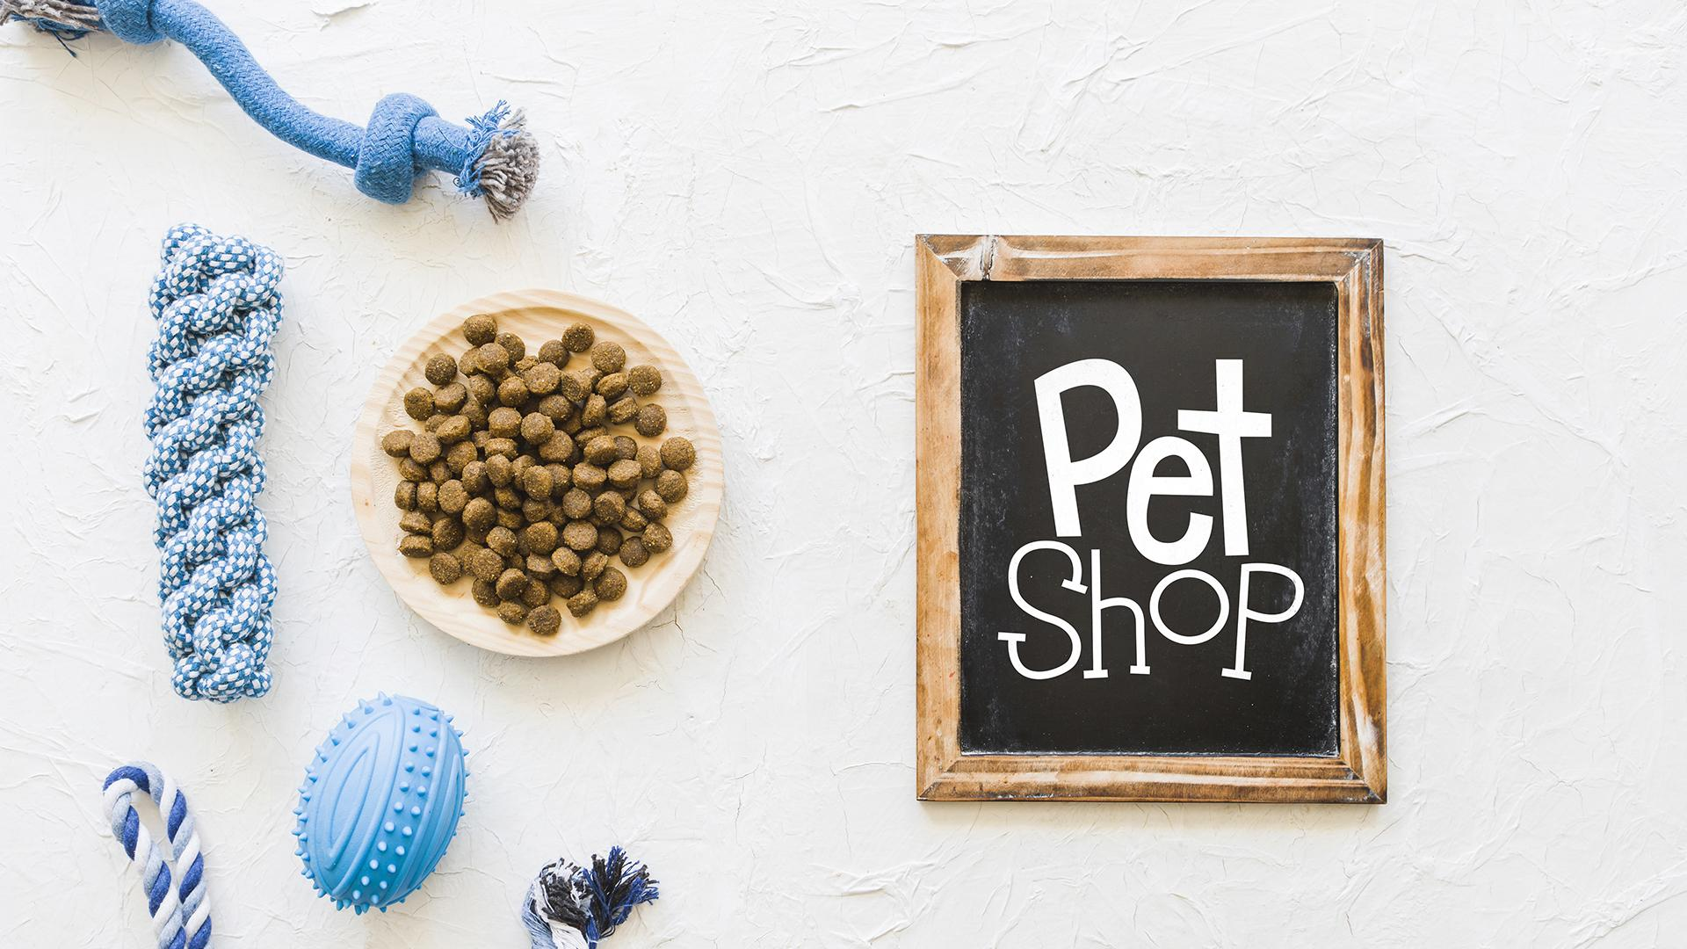
INTRODUCTION
About: Marilyn & Rona’s Pet Shop is located in the borough of Queens and focuses on pet products ranging from accessories, toys, medication and food.
Goal: Marilyn & Rona’s Pet Shop wants to explore ways to expand customer reach and increase revenue. To eventually include an online marketplace for their business.

Slide 3
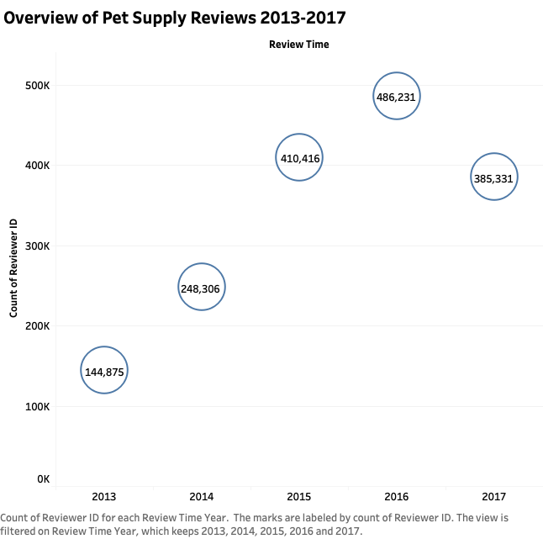

SAMPLING REVIEWS
2013-2017 has shown a lot of activity in Pet Supplies Reviews.
Generally there has been an increase in reviews over this time period.
The most reviews during this time frame were in 2016 with nearly 500K reviews.

Slide 4
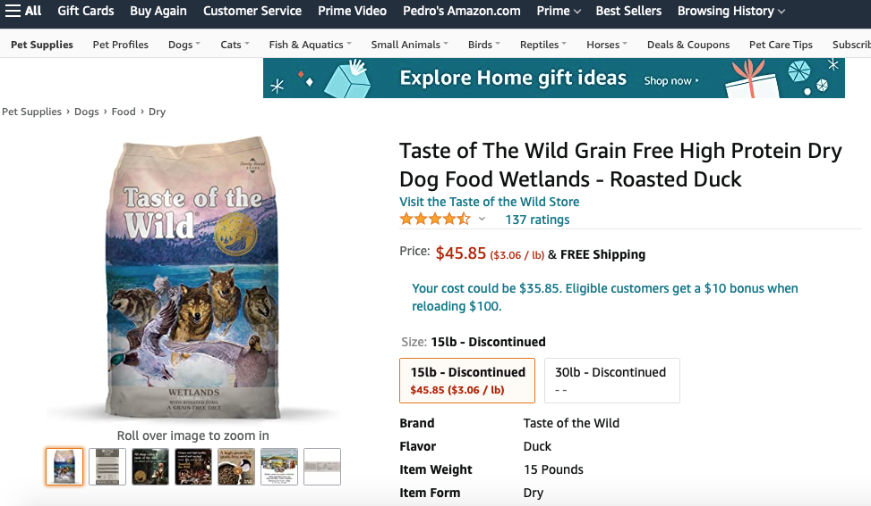
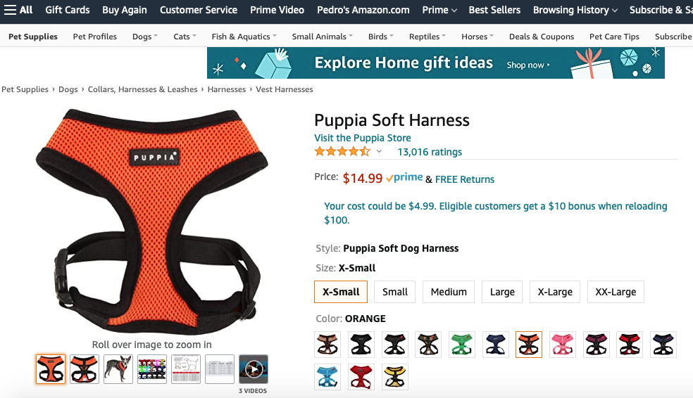
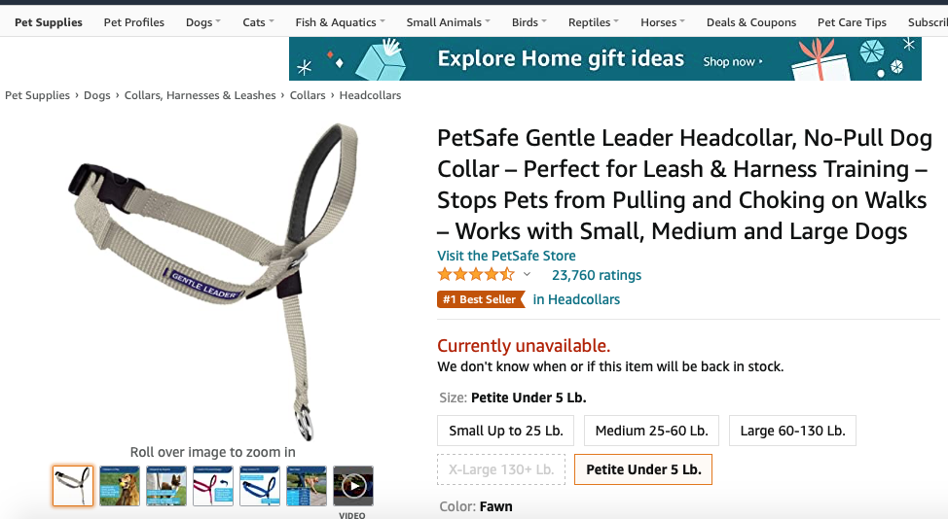
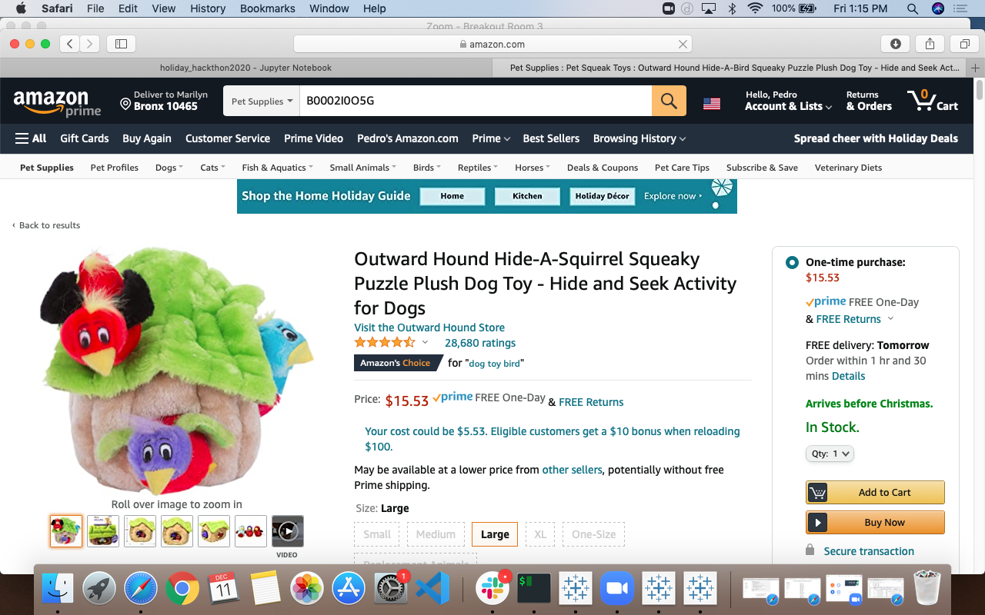
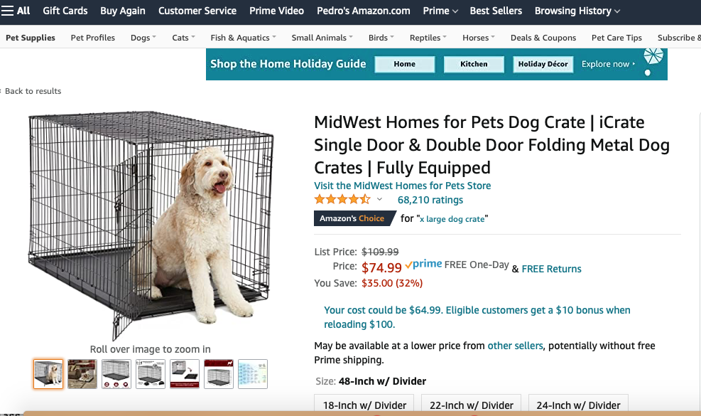
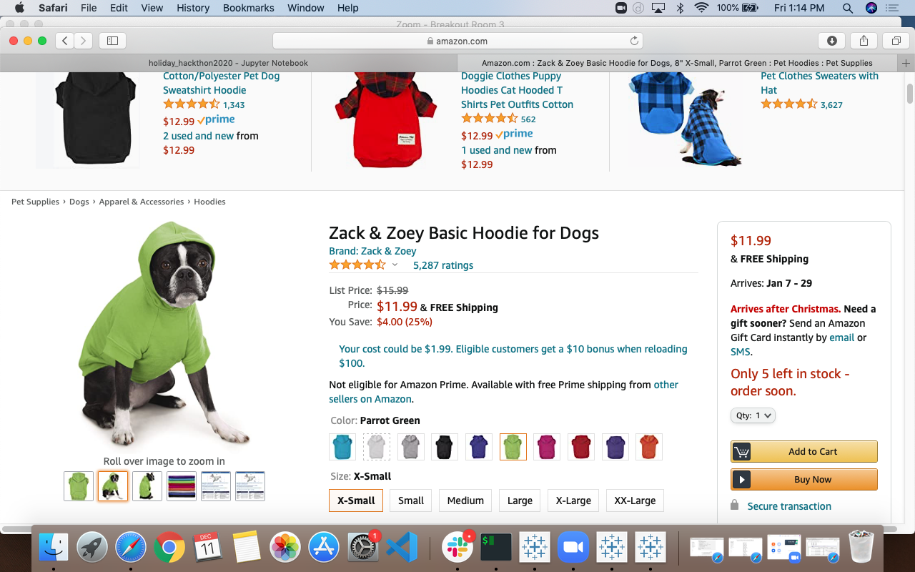
TOP REVIEWED PRODUCTS

Slide 5
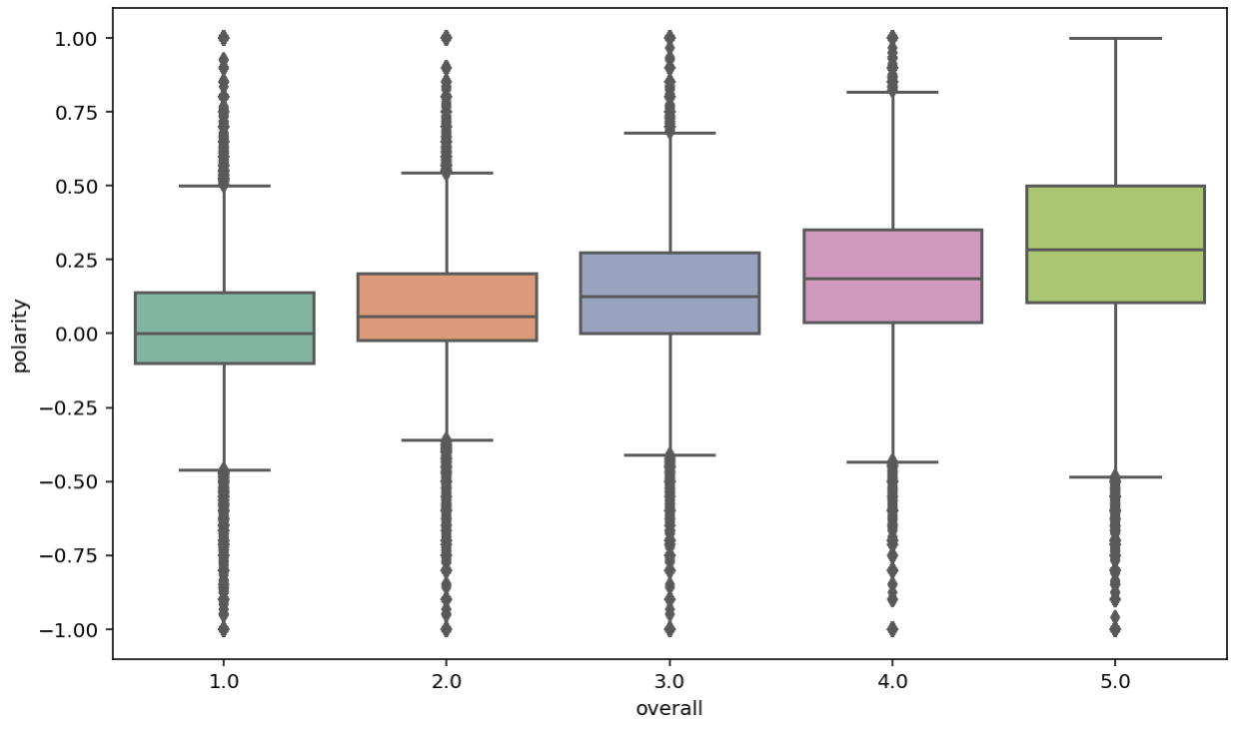
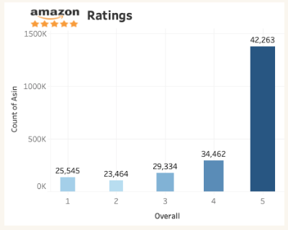
POSITIVE AND NEGATIVE REVIEWS
Polarity Grouped By Rating
Count of Rating
Polarity is a measure which lies in the range of [-1,1] where 1 means positive statement and -1 means a negative statement.
Notes:
Reviews with 1 or 2 stars are negative
Reviews with 4 or 5 stars are positive
Reviews with 3 stars are neutral therefore excluded from this analysis
Most polarity scores are above zero, meaning most of the reviews are positive sentiment in the data, this is in line with the star rating distribution we discovered earlier.

Slide 6
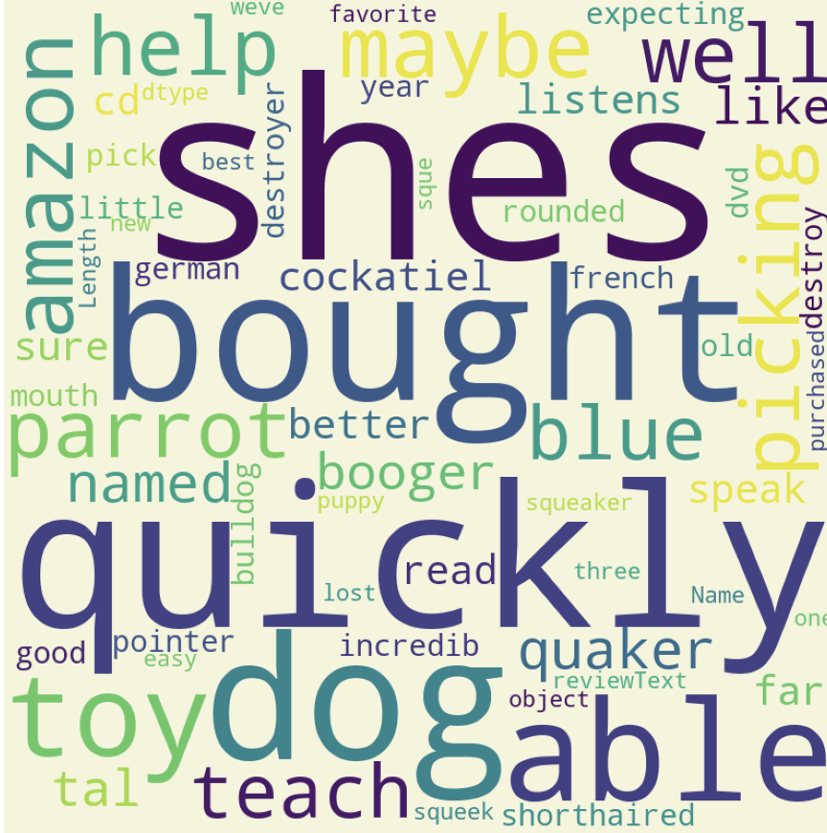
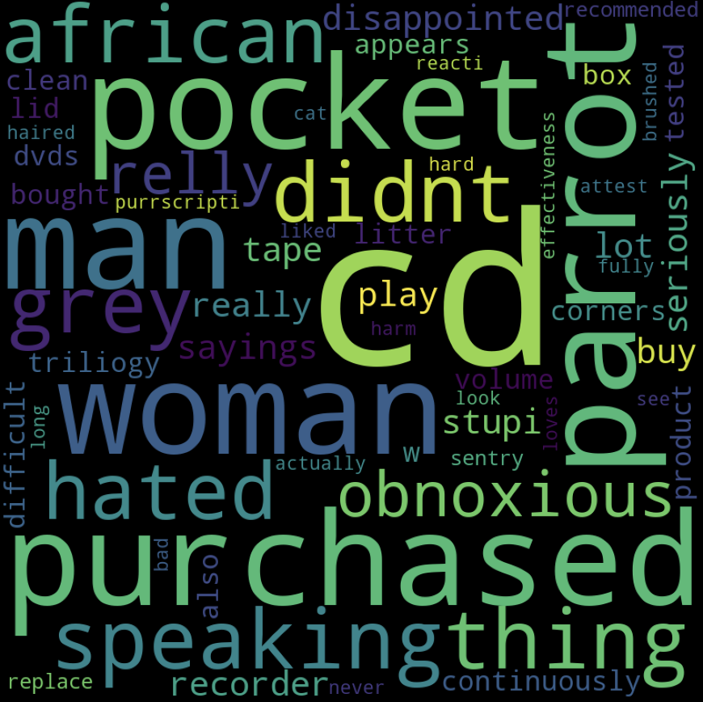
EXPLORING WHAT AMAZON REVIEWS SAY
Reviews with POSITIVE Sentiments
Reviews with NEGATIVE Sentiments

Slide 7
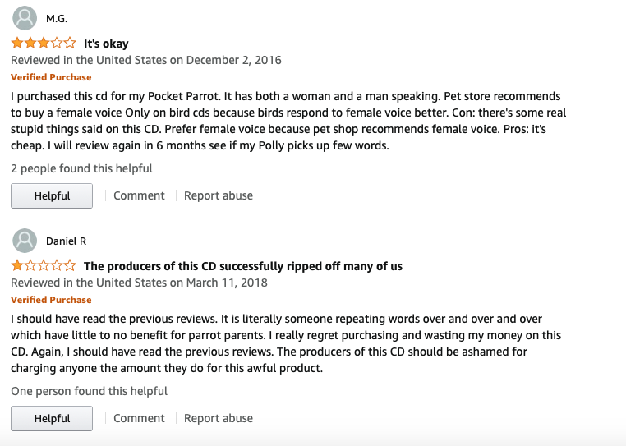

RECOMMENDATIONS
YES move inventory into Amazon!
Start with small products.
Offer either free shipping or free return.
Dog supplies is the way to go.
Don’t forget about bird owners who have a lot to say in their reviews.

Slide 8
THANKS!
NEXT STEPS
Explore customer locations
Gauge price points for products
Once online store is established, explore seller versus Amazon fulfilled orders
Conduct classifier model to classify sentiments of reviews based on words.
Questions - email us?
Marilyn Alonzo-Flores: marilyn.sasha@gmail.com Rona Masab: rmasab@gmail.com

